Slide 1

Boolean Variables and Operators
A logical condition evaluates to true or false,
You can use a boolean variable to store the results of a condition
The boolean data type has exactly two values, denoted false and true.
boolean failed = true;
Later in your program, use the value to make a decision
if (failed) // Only executed if failed has been set to true
{ . . . }

Slide 2
Boolean Variables and Operators
You often need to combine boolean values when making complex decisions
An operator that combines boolean conditions is called a boolean operator.

Slide 3
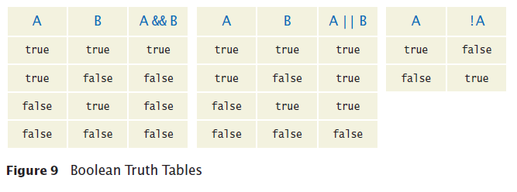
Boolean Variables and Operators
The boolean && operator is called and
Yields true only when both conditions are true.
if (condition1 && condition2){
//BLOCK EXECUTES ONLY IF BOTH CONDITIONS ARE TRUE
}

Slide 4
Boolean Variables and Operators
if (condition1 && condition2){
//BLOCK EXECUTES ONLY IF BOTH CONDITIONS ARE TRUE
}
if (tempScale.equals(“C”) && temp >32 && temp <212){
System.out.println(“The state of the water is liquid);
}

Slide 5
Boolean Variables and Operators
The || operator is called or
Yields the result true if at least one of the conditions is true.
if (condition1 | | condition2){
//BLOCK EXECUTES IF EITHER CONDITION IS TRUE
}

Slide 6
Boolean Variables and Operators
if (condition1 | | condition2){
//BLOCK EXECUTES IF EITHER CONDITION IS TRUE
}
if (weatherCond.equals(“rain”) || weatherCond.equals(“snow”) {
System.out.println(“STAY INSIDE!”);
}

Slide 7
Boolean Variables and Operators
if (restCuisine.equals(“mexican”) && !longWaitTime ){
System.out.println(“Stay and eat”);
}

Slide 8
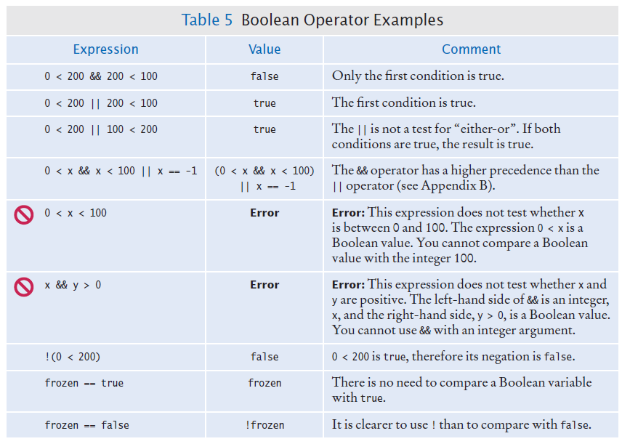
Boolean Variables and Operators

Slide 9
Application: Input Validation
You need to make sure that the user-supplied values are valid before you use them.
Elevator example: elevator panel has buttons labeled 1 through 20 (but not 13)
The number 13 is invalid
if (floor == 13)
{
System.out.println("Error: There is no thirteenth floor.");
}
Numbers out of the range 1 through 20 are invalid
if (floor <= 0 || floor > 20)
{
System.out.println("Error: The floor must be between 1 and 20.");
}

